Slide 1

Machine Learning Foundation Project Submission
By
HARSHARAN SINGH KOHLI

Slide 2
AGENDA
INTRODUCTION
ABOUT DATASET
DATA PRE-PROCESSING
EXPLORATORY DATA ANALYSIS
REGRESSION ANALYSIS
CONCLUSION

Slide 3
INTRODUCTION
Goal for this Project was to use Regression techniques to estimate the Sale Price of a House

Slide 4
My Dataset comes from Github Projects-House Prices.txt
Dataset contains house sales prices and its features for homes between 2006 & 2010
There are a total of 1460 samples (rows)
and 81 columns in the dataset
There are 38 columns with a numeric
datatype and 43 columns with an object
datatype.
I am planning to use 36 attributes in
the dataset
ABOUT DATASET

Slide 5
Out of selection, 3 attributes were having null values (Lot Frontage,Garage Year Built & Mas VnrArea
The null values were filled using the mean & the mode values and were cleaned
Observations under consideration are 1460 X 36
SalesPrice is the target variable
DATASET PRE-
PROCESSING

Slide 6
The distribution of SalePrice is positive (right) skewed because the mean of SalePrice (180921.195890) lies to the right of the median(50%) value (163000), on a distribution plot
Majority of the values of SalePrice lie at
less than 214000 as shown by our 75%
value.
The maximum value of SalePrice is 755000,which is clearly an outlier because its value is very distant from the 75% value.
People tend to move during the summer
June and July were the months in which most houses were sold. The median house price was at its peak in 2007 (167k) and it was at its lowest point during the year of 2010 (155k) a difference of 12k. This might be a consequence of the economic recession. Less houses were sold and built during the year of 2010 compared to the other years.
EXPLORATORY DATA ANALYSIS

Slide 7
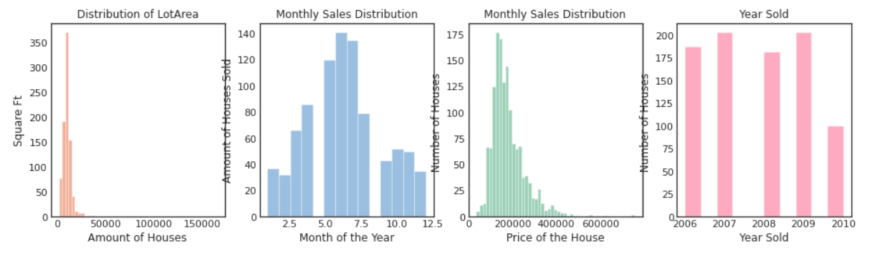
EDA-Graphical Representations

Slide 8
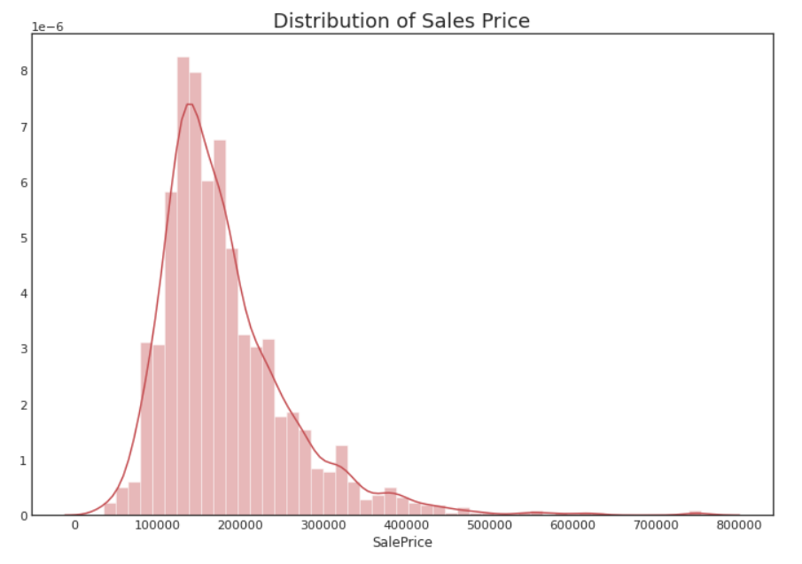
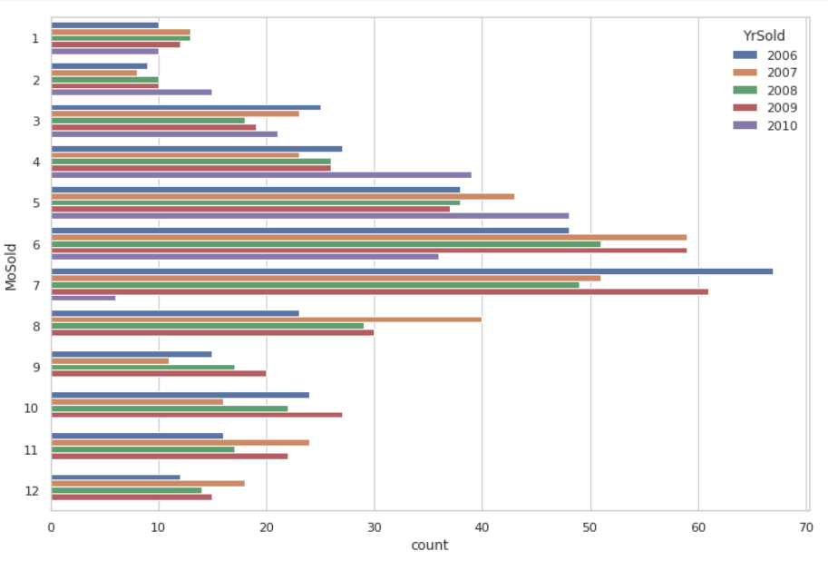
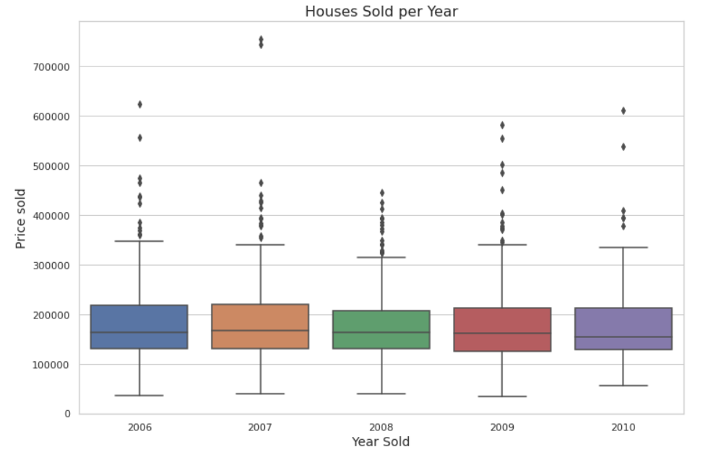
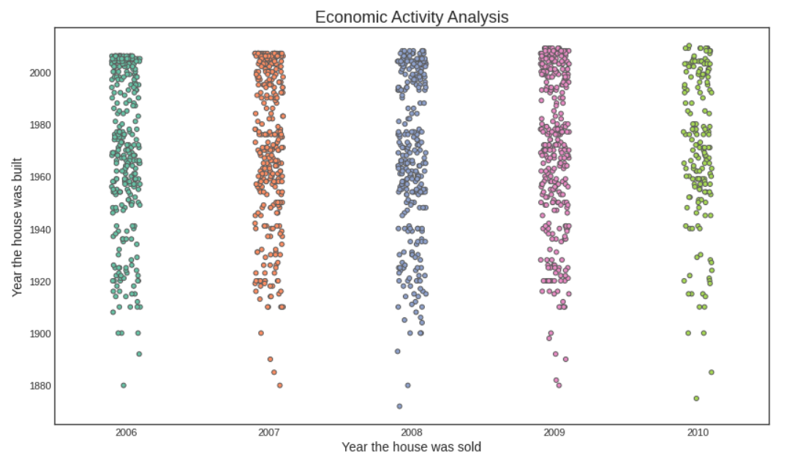

Slide 9
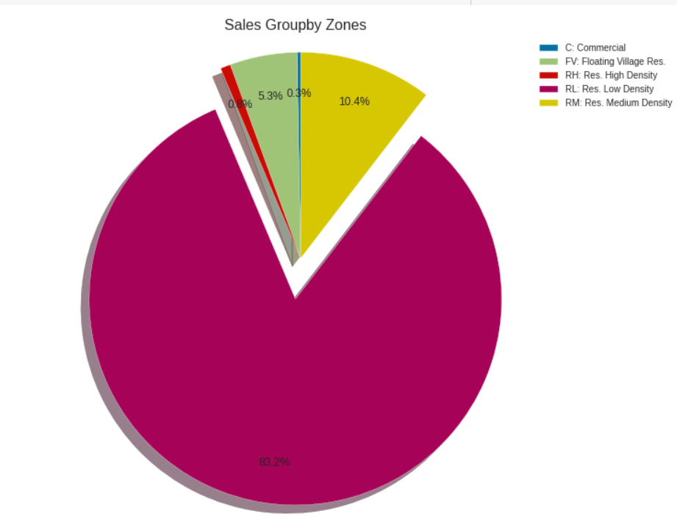
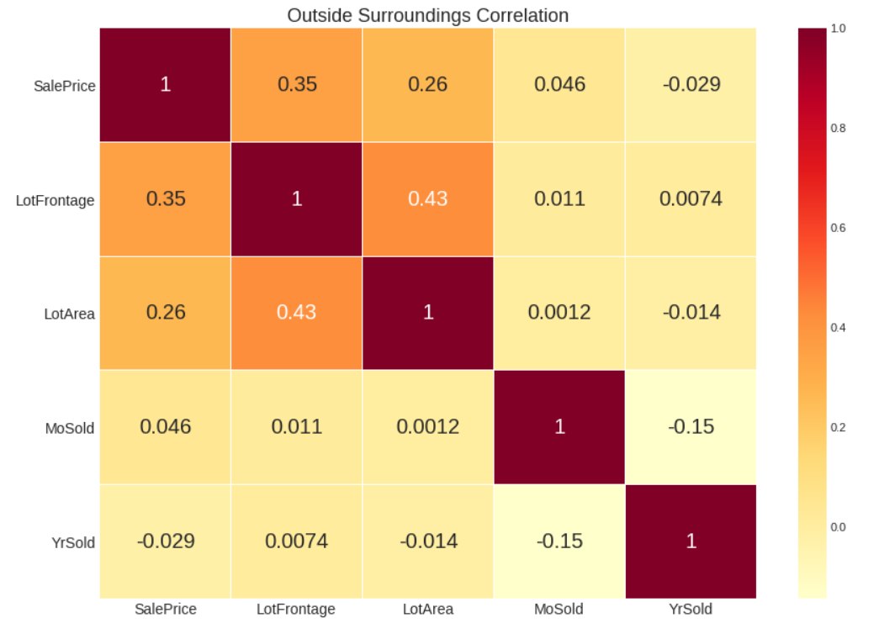
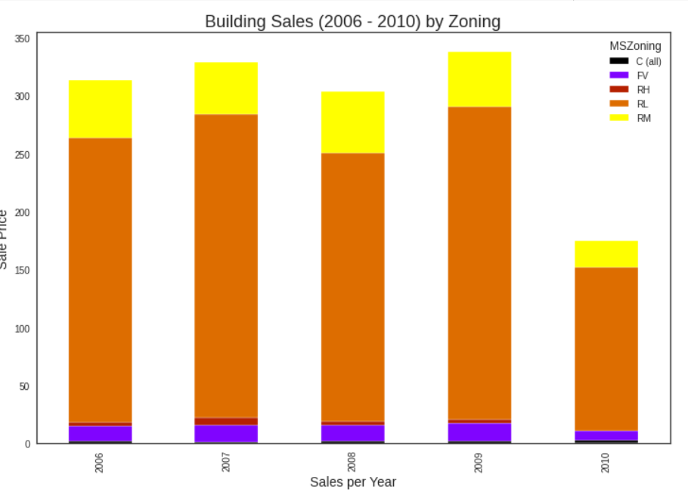
Outside Surroundings Correlation
Lot Area and Lot Frontage influenced hugely on the price. However, YrSold does not have that much of a negative correlation with SalePrice
Which neighborhoods gave the most revenue. This might indicate higher demand toward certain neighborhoods
Building Sales by Zoning

Slide 10
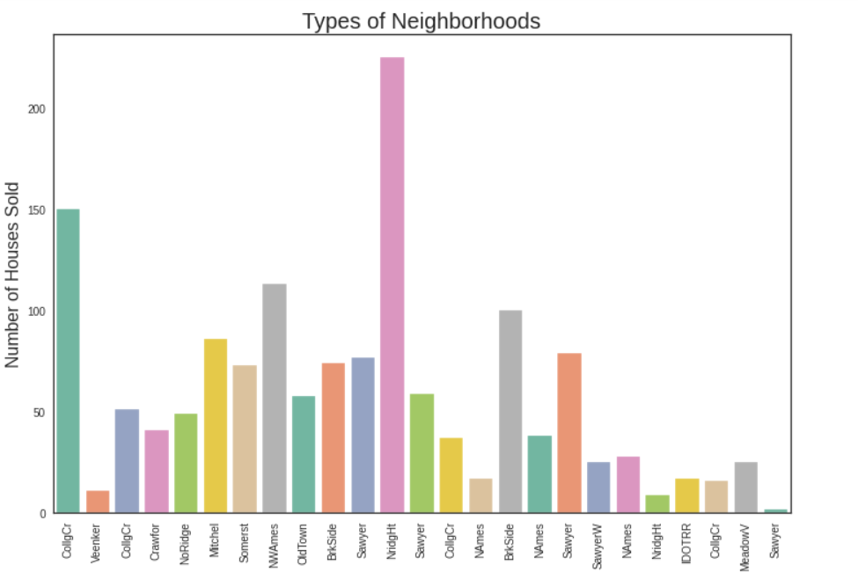
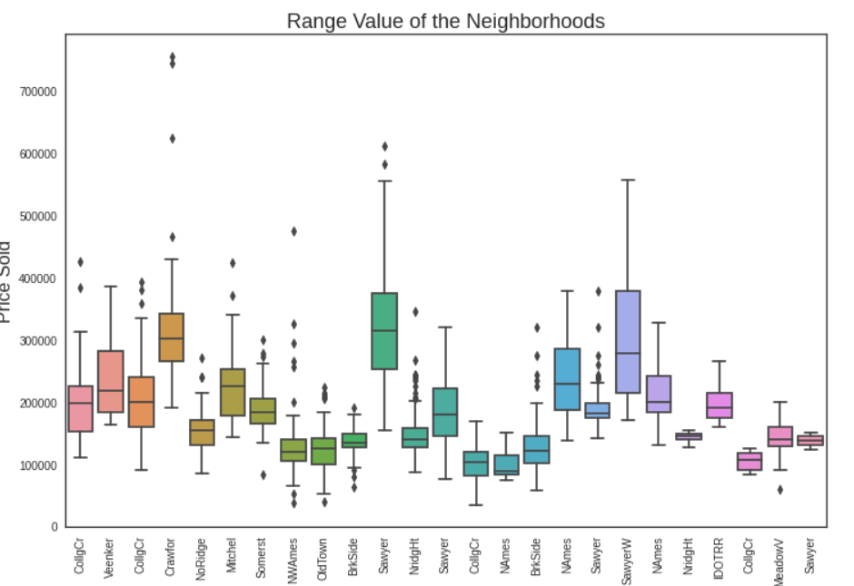
Types of Neighbourhoods
Sawyer and SawyerW tend to be the most expensive neighbourhoods

Slide 11
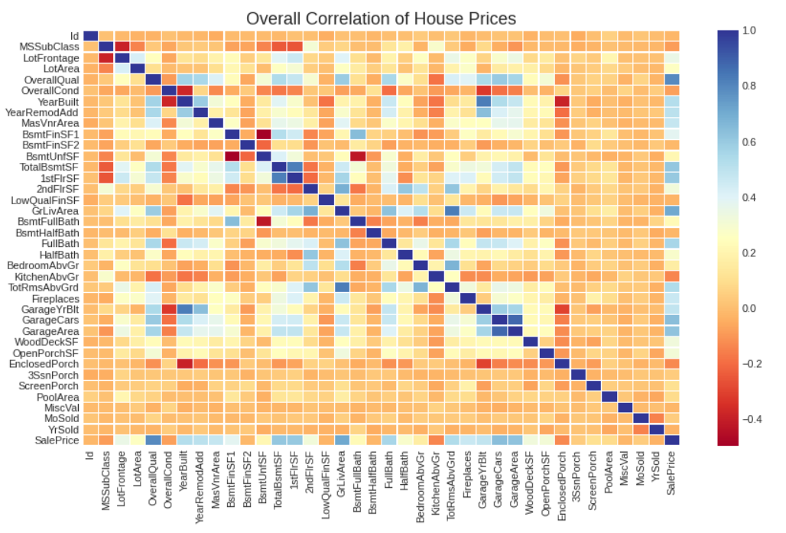
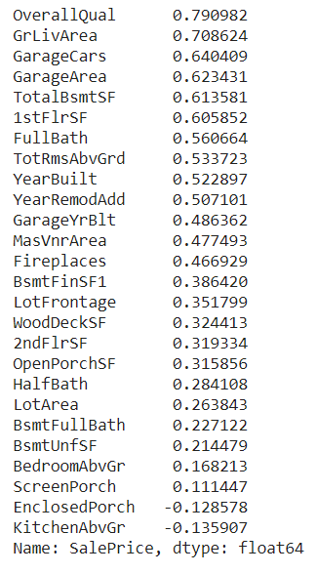
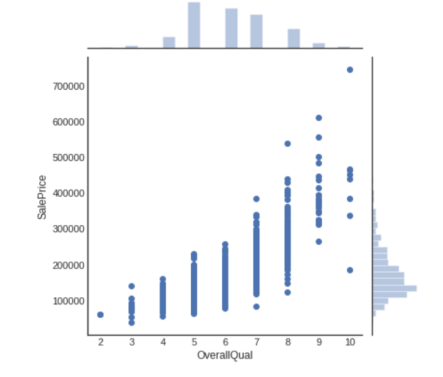
Overall Correlation of House Prices
Overall Quality has the Highest +ve Correlation with the Sales Price.Now let’s analyse all other variables-of-interest.

Slide 12
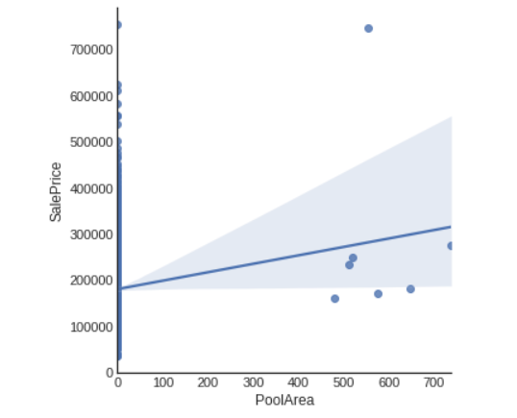
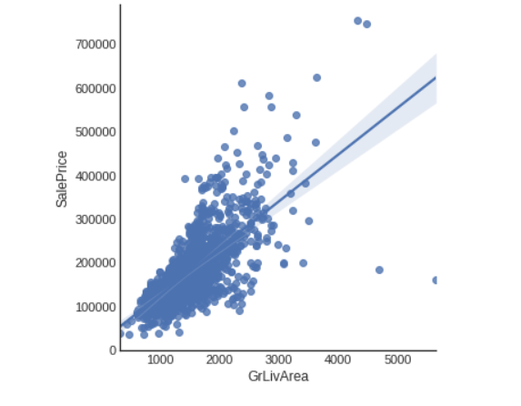
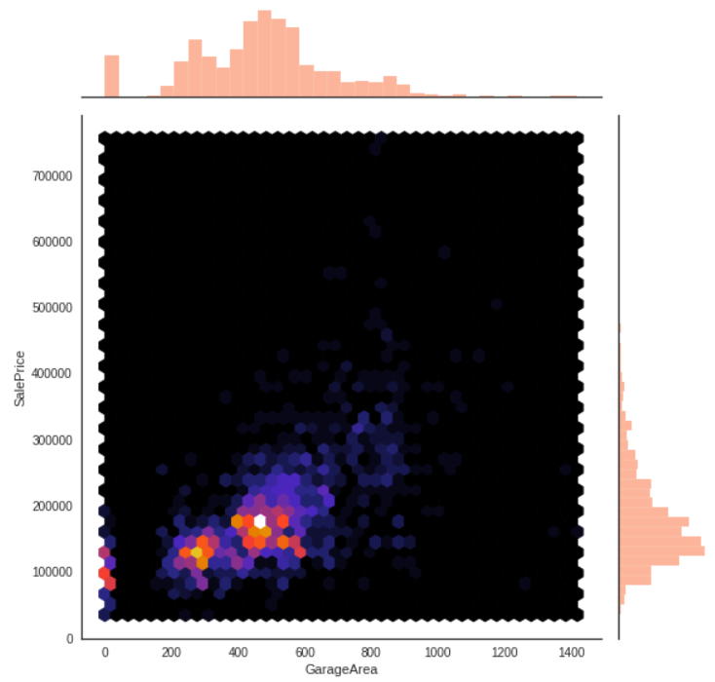
Correlation between Sales Price and Pool Area,Living Area & Garage Area.Its a Positive Correlation

Slide 13
REGRESSION
ANALYSIS
Datasets :Divided into 60% Training and 40% Testing
ANALYTICS RESULTS
 |  |  |  | R2
 | y_train | y_test |  | y_train | y_test
Linear Regression |  |  | XG Boosting | 0.999072084 | 0.88315
MAE | 19943.67 | 22179.25
MSE | 975840699.6 | 1722722649
RMSE | 31238.44906 | 41505.69418
R2 | 0.844872218 | 0.727892698
Decision Tree
MAE | 0 | 29739.38185
MSE | 0 | 2738709345
RMSE | 0 | 52332.67951
R2 | 1 | 0.567415677
Random Forest |  |  | Random Forest Regressor | 0.977126383 | 0.83501
MAE | 7103.795879 | 19022.47683
MSE | 161350830.8 | 1046464779 | Light GBM Regressor | 0.989463672 | 0.85218
RMSE | 12702.39469 | 32349.10785
R2 | 0.974350325 | 0.834708908

Slide 14
CONCLUSION
XG Booster shows the best R2 value for Train (0.999072084) and Test Data (0.88315) out of all the applied Algorithms
Also below are the values for MAE,MSE & RMSE for the XG Booster
 | y_train | y_test
MAE | 1798.815002 | 17585.61499
MSE | 5837111.02 | 739733698.7
RMSE | 2416.011387 | 27198.04586
THANK YOU

